Slide 1
Going beyond concepts: Nurturing practices in science & engg
Sahana Murthy
Educational Technology, IIT Bombay

Slide 2
What do we want our students to be able to do?

Slide 3
Solving a problem - Each one type one
You are participating in an electric car race in which you are required to design an electric car of weight 5kg with wheel diameters of 4” that can traverse a track of 50m in less than 5s.
Can you use the motor of a vacuum cleaner to build this car?
In order to solve this problem, what knowledge and skills does one need?
1) can start with concepts, but think what else is required
2) be specific, go beyond saying “problem solving” skills

Slide 4
What do we want our students to learn?
‘Understand’ content: concepts, hierarchy and interconnectedness
Solve problems
Model phenomena
Design systems
Analyze, troubleshoot
Critique, Argumentation
Work in teams, communicate …
(ABET, NGSS, NMEICT pedagogy project, Sheppard 2009, Pellegrino 2006…)

Slide 5
What do scientists & engineers do in professional practice?
Integrate, apply concepts
Formulate questions
Solve complex, ill-defined problems
Design systems
Create, test, refine models
Multiple representations
Design experiments
Formulate and test hypotheses
Evaluate claims, designs, feasibility..
(Jonassen 2000, Sheppard 2007, NRC 2012)

Slide 6
What are practices ?
“.. behaviors and actions that scientists engage in as they investigate and build theories about the natural world, and that engineers use as they design and build models and systems”
(Next Generation Science Standards, US)
Examples –
hypothesis generation & testing, data representation and interpretation
design thinking, estimation, troubleshooting, computational thinking

Slide 7
Examples of practices in your domains?

Slide 8
More about practices
Require integration of domain knowledge and processes in specific ways, for example:
Could have broader applicability, for example: estimation of other physical quantities (energy, weight …)
Alternate names : thinking skills, scientific habits of mind, trans-disciplinary habits, 21st century skills, ….
(Pellegrino & Hilton, 2012; National Research Council, 2012; Mishra, Koehler & Henrikson, 2011)

Slide 9
Raise your hand if you have heard any below
Student: “I studied/know the concept really well, it’s just that I cannot solve this problem”
Teacher: “I showed students N examples of how to apply it, but few could apply it in a different context on the test”
Employer / industry / McKinsey report:
“Most engineering graduates don’t have the necessary skills and we have to retrain most entry level candidates”

Slide 10
Practices are not automatically developed
Challenging for novices
‘Knowing’ domain concept ≠ applying practice
Students are not able to apply such practices to solve problems after instruction in disciplinary content alone
Students need to apply practices reﬂectively and critically
Implication:
Address teaching & learning of practices explicitly
(Salomon & Perkins 1989; Eckerdal et al 2006; Rivera-Reyes & Boyles, 2013; Dym et al, 2005; Atman et al, 2007; Etkina et al, 2010; Moore et al, 2013).)

Slide 11
Our Project – two related goals
What is the cognitive process of learning of practices?
- leads to theory of developing expertise
How to support students’ learning of practices?
- leads to design of learning environments, teaching strategies, learning tasks, scaffolds
Method – Design-based research, iteratively addresses both goals

Slide 12
The LEAP Model (LEArning of Practices)
Notes:
Has to satisfy the requirement we laid before – explicitly apply practice, while integrating domain concepts

Slide 13
The LEAP Model (LEArning of Practices)
abstract
The practice gets developed as the learner goes through cognitive tasks at progressive levels of abstraction.
Progression between levels is triggered by monitoring and control.
GENERALIZE
monitor
control
SYNTHESIZE
monitor
control
EVALUATE
monitor
control
EXECUTE
concrete
Notes:
These are not steps of problem solving
Loosely translating this – start with concrete specific tasks such as identify imp parameters in the car problem, and go towards more abstract. Not enough ot stay at abstract level - Move back & forth between concrete and abstract,

Slide 14
Example: Estimation
(PhD thesis of Dr Aditi Kothiyal, 2019)

Slide 15
Recall – estimation problem
You are participating in an electric car race in which you are required to design an electric car of weight 5kg with wheel diameters of 4” that can traverse a track of 50m in less than 5 seconds.
Can you use the motor of a vacuum cleaner to build this car?
In order to solve this problem:
Concepts, relationships, principles – power, force & motion
Understanding multiple interconnected systems (electrical & mech)
Engineering knowledge (eg efficiency of motor)
Operating conditions
Decision making
….

Slide 16
Learning goal: Estimation
An analysis to determine a physical quantity in a physical system to some level of accuracy without complete information.
Estimation is a common practice in engineering:
Initial step of design, evaluate the feasibility of an idea, eliminate candidate design solutions, plan projects
Estimation is complex, ill-structured, many unknowns and uncertainties, yet make key decisions – research challenge and teaching challenge

Slide 17
Understanding the cognitive process of estimation
Study 1
Experts - engineering faculty & professionals
Cognitive ethnography, microgenetic analysis
Study 2 / 3
Novices – BTech students
Cognitive ethnography /Lab study; Microgenetic / Thematic analysis

Slide 18
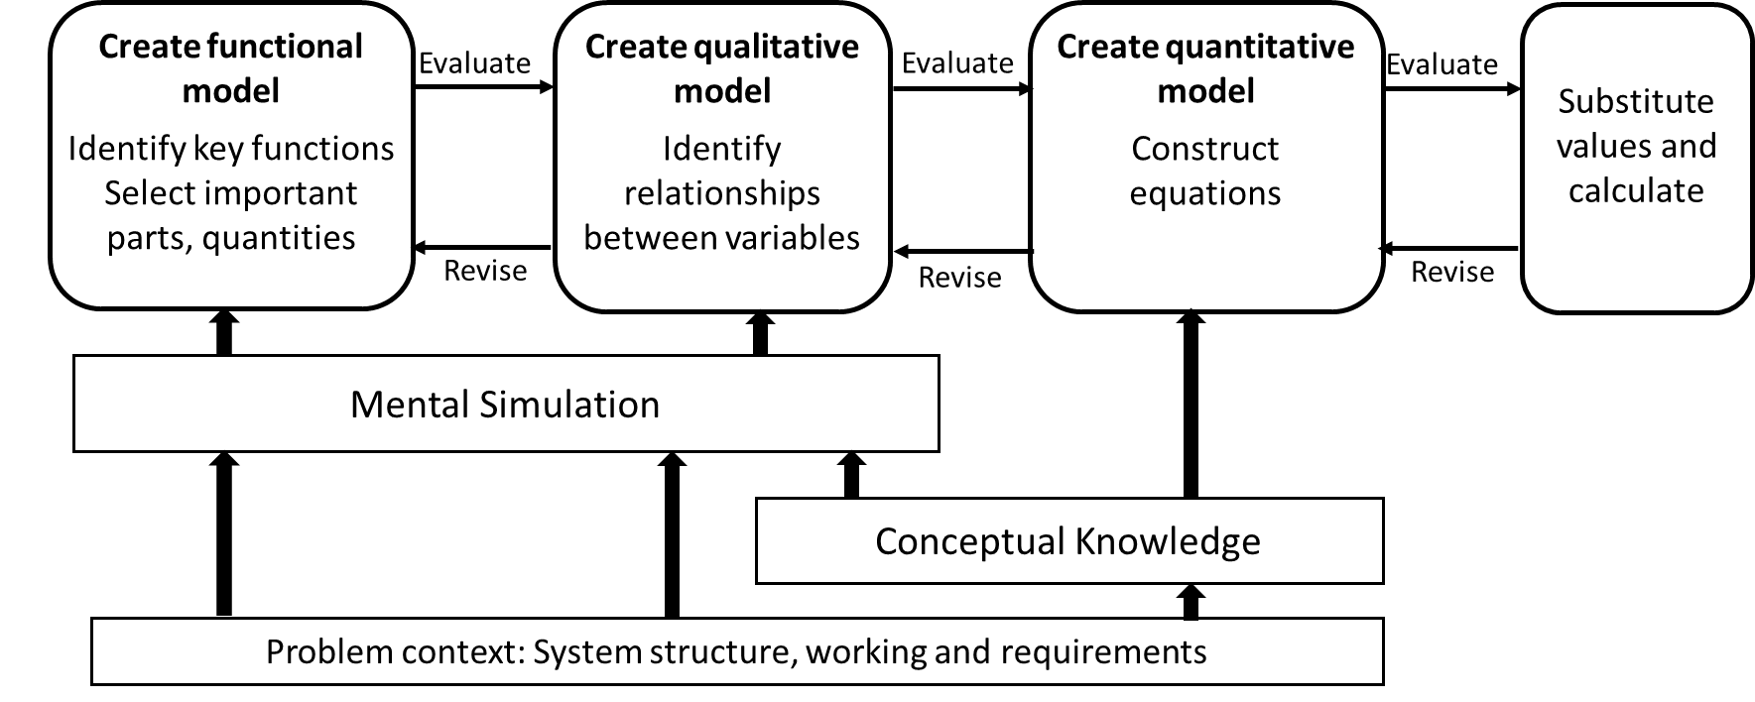
Understanding the cognitive process of estimation
Model the system

Slide 19
Understanding the cognitive process of estimation
Experts build models (3-phase) and do mental simulation
Problem context integral in solving problem
Novices search for mathematical models, begin with equations
Novices need scaffolds for building the model of the system, for imagining and simulating, and to apply concepts in the problem context
Implication - Design the learning environment to support process

Slide 20
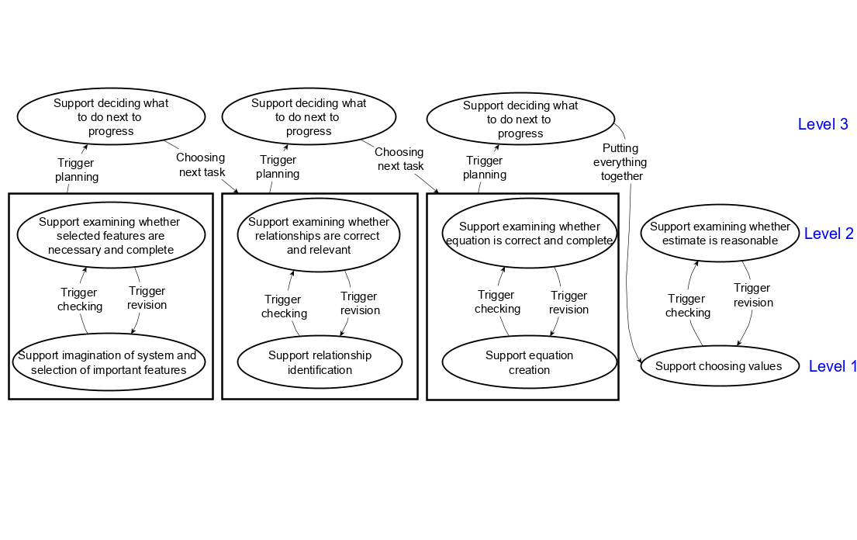
Zooming in – process involves levels of abstraction
Functional model
Qualitative model
Quantitative model

Slide 21
Design the learning environment with supports at each level
Support for planning and monitoring
Support for evaluation of model
Support for modelling the system

Slide 22
Technology-enhanced learning environment
Computer-based software
Problems on estimating physical quantities - Power, motion, force
Self-learning / can be used in lab guided by an instructor
Interactive simulations
Questions, text-boxes
Prompts, pop-up hints
Feedback and basic adaptation
Tools for graphing, diagramming, calculator

Slide 23
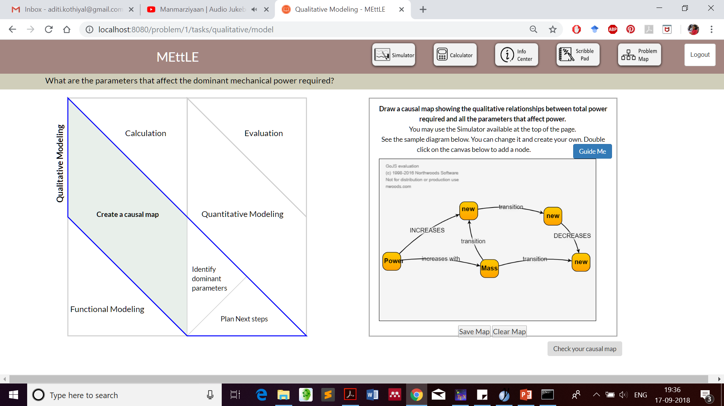
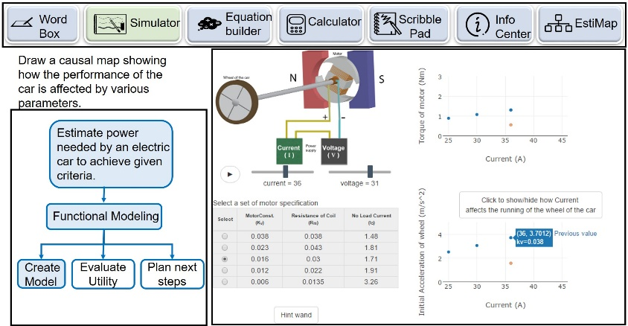
TEL environment: MEttLE

Slide 24
How does MEttLE support learning of estimation?
Building the model
Qualitative model

Slide 25
How does MEttLE support learning of estimation?
Focus question for current modelling sub-goal
Model-building guidance
Model-building affordance

Slide 26
How does MEttLE support learning of estimation?
Simulator – support for imagination, identifying dominant parameters, relationships between variables

Slide 27
How does MEttLE support learning of estimation?
Evaluating the model
Qualitative model

Slide 28
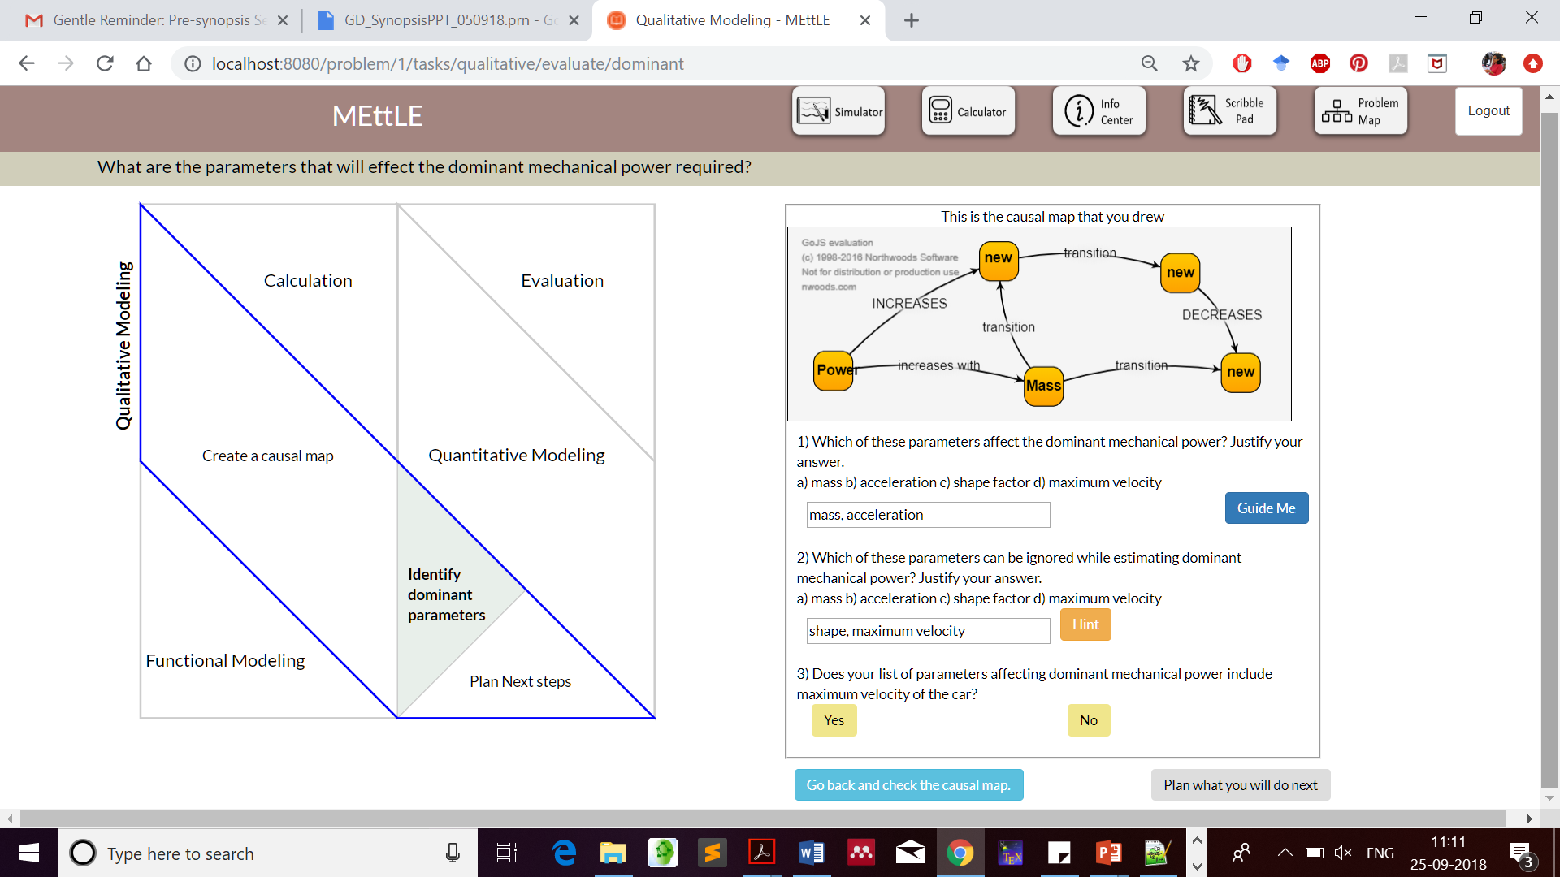
How does MEttLE support learning of estimation?
Guidance for model evaluation
Model-evaluation prompt

Slide 29
How does MEttLE support learning of estimation?
Metacognitive triggers
Qualitative model

Slide 30
How does MEttLE support learning of estimation?
Trigger revision
Trigger planning

Slide 31
Takeaway
The learning process involves:
Levels of reasoning, from concrete to abstract
Metacognitive processes (planning, monitoring, control)
Design of LEs should include:
Tasks at each level and corresponding scaffolds to do the task
Metacognitive prompts to support the learner to accomplish tasks, and to trigger revision or plan next steps
Scaffold identification of appropriate conceptual knowledge and its application in the practice

Slide 32
Example: Micro-Macro thinking
(PhD thesis of Dr Anura Kenkre, 2017)

Slide 33
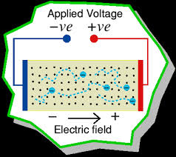
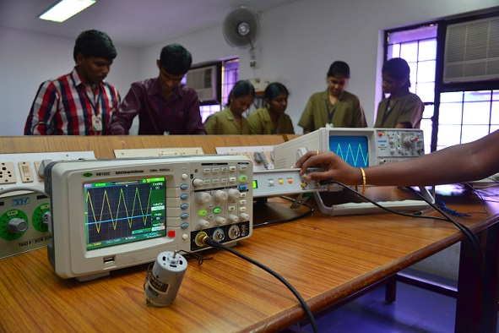
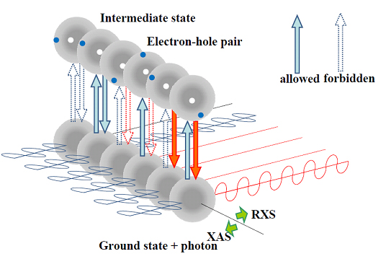
Learning goal: Micro – macro thinking
Microscopic
(invisible elements, molecular level)
Macroscopic
(directly observable)
Establish a link between invisible /theoretical variables (micro) and its corresponding manipulable variables (macro) in order to predict the behavior and functionality for any given system

Slide 34
Practices involved in micro-macro thinking
Identify, describe patterns in the micro world
Model the behavior of the entities in the micro-world
Make a prediction of macro-world variables based on micro-world model
Decide whether prediction and actual experimental outcome agree/disagree
Identify assumptions and implications
Revise model as required

Slide 35
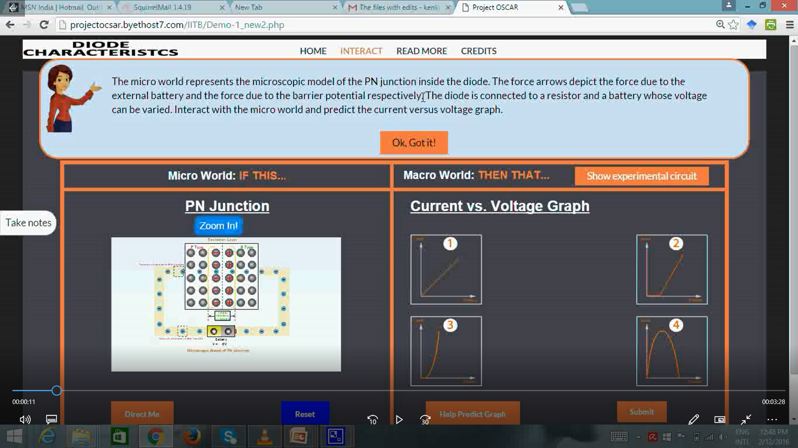
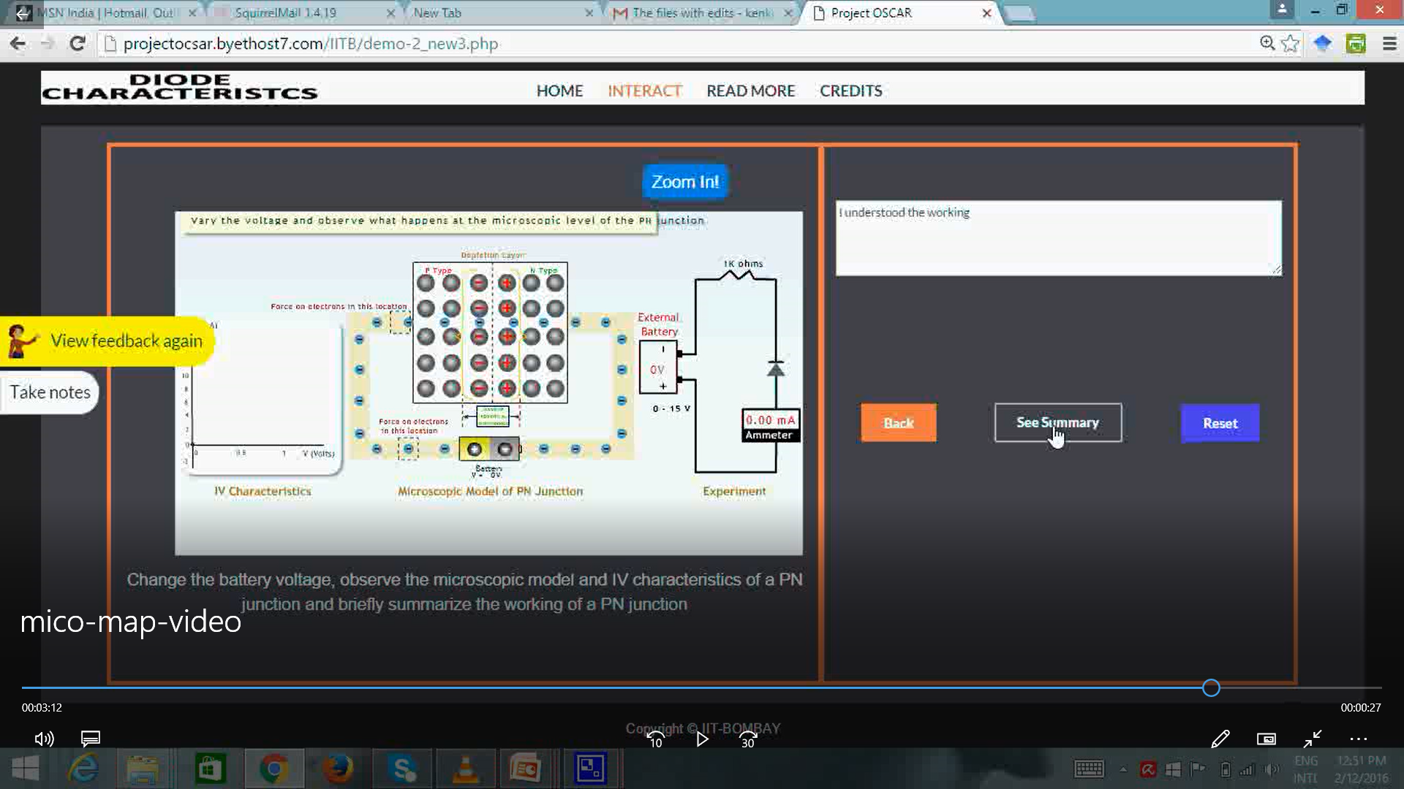
Design of TEL environment: Mic-O-Map
Micro: electron motion, barrier potential, # e’ns in conduction & valence band
Macro: voltage, current, doping, ..

Slide 36
Mic-O-Map pedagogical features
Microscopic Observations Macroscopic Predictions
Learning activities
Guided questions, navigation prompts
Variable manipulation to understand relationships
Model microscopic behaviour (e’n motion, barrier potential, … )
Prediction tasks – V-I graph, justify based on microscopic model
Analysis tasks – analyze macro outcome, correlate with micro model
Scaffolds
Multiple representations
Pedagogical agent
Constructive feedback
Metacognitive prompts

Slide 37
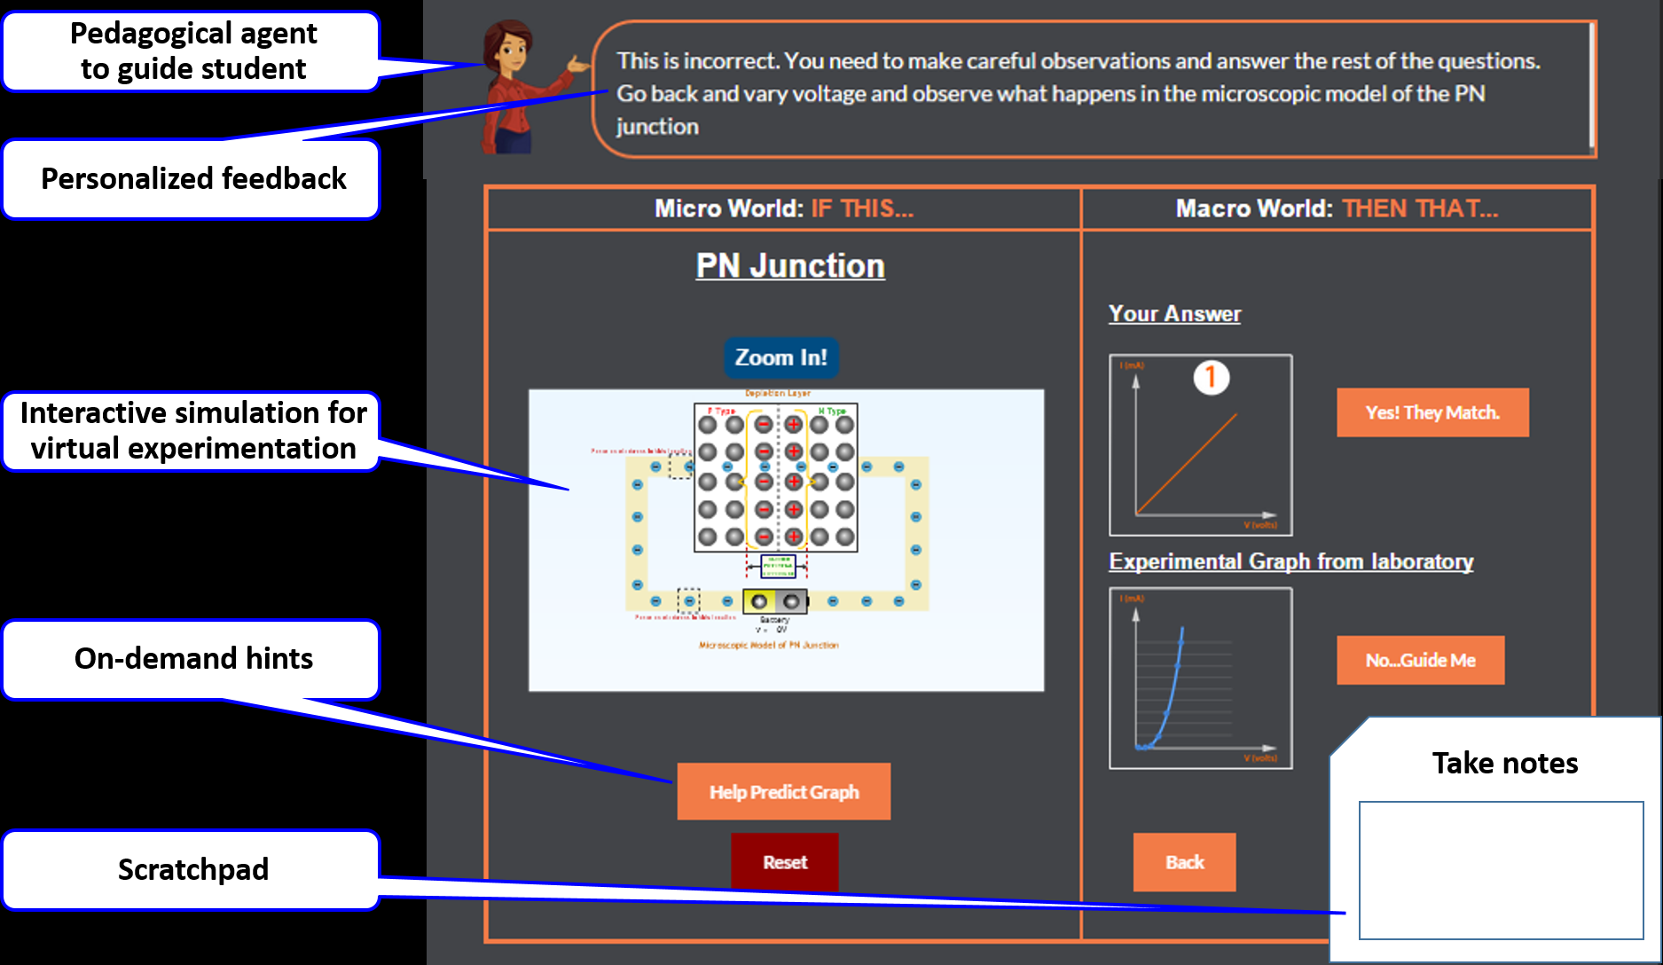
Design: Mic-O-Map

Slide 38
How does Mic-O-Map support learning of practices?
Tasks and scaffolds in Mic-O-Map foster students to do “productive actions” at various levels of reasoning. Students who did these actions developed expertise in the practices of micro-macro thinking.
Relate multiple reprsnts (ckt, e’n motion, graphs)
Write summary considering micro & macro aspects
Metacognitive – Reflection prompts
Synthesize:
Integrate micro-macro link
Evaluate:
Strengthen micro-macro link
Decide if prediction matches experiment outcome
Revise prediction if necessary
Metacognitive – Assertion & evaluation prompts
Execute:
Establish micro-macro link
Manipulate simulation variables, make prediction
Guided wayfinding to do tasks
Metacognitive – Prompts to repeat if unable

Slide 39
Do students develop practices?
Research studies: Total 250 students, 6 topics
[2-grp quasi-expt (N=73), single group pre-post (N=135), repeated measures (N=29)]
Findings:
Statistically significant improvement in describing observed patterns, devising explanations, making predictions with correct reasoning, deciding outcome matching

Slide 40
Back to the LEAP model

Slide 41
The LEAP Model (LEArning of Practices)
abstract
GENERALIZE
monitor
control
SYNTHESIZE
monitor
control
EVALUATE
monitor
control
EXECUTE
concrete

Slide 42
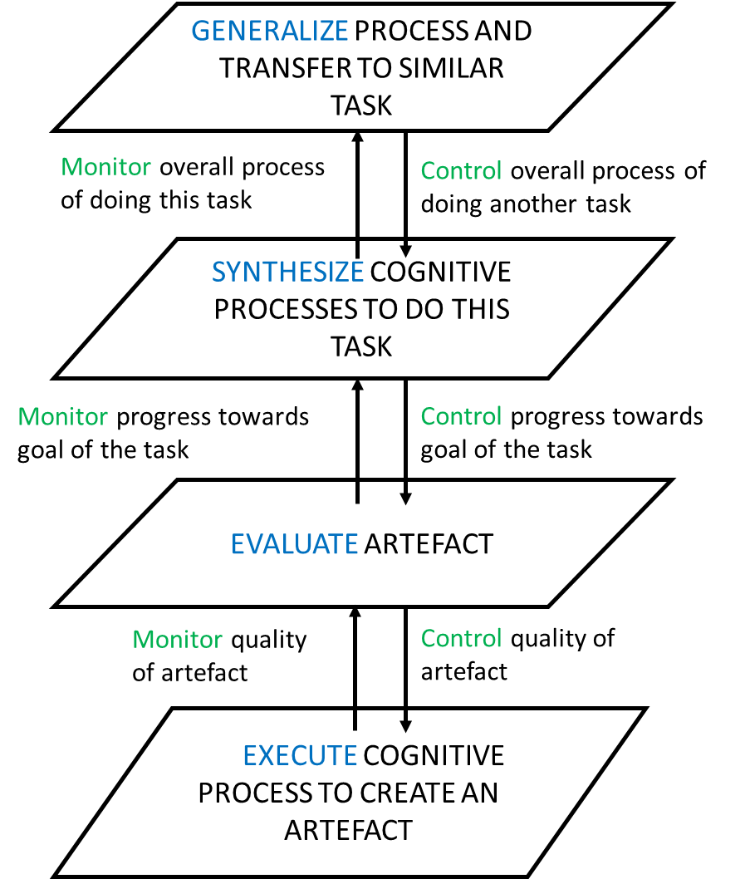
The LEAP Model (LEArning of Practices)
abstract
How will you solve the next problem?
How did you solve this problem?
Evaluate: does your answer make sense?
Do this task.
concrete

Slide 43
If you are teaching a practice
Use the LEAP framework to design the learning experience:
Make learners do tasks at progressively higher levels of abstraction – Execution, Evaluation, Synthesis, Abstraction.
Give meta-cognitive prompts to take learners from one level to next.
Provide scaffolds during learning:
Support learners to complete a task.
Provide constructive feedback frequently.
Provide sufficient and diverse practice:
Expand scope of problems from near areas to far areas.
Gradually fade the scaffolds to make learners independent.

Slide 44

How does LEAP help learners?
Standard route:
………..
UG:
Solve many back of chapter problems, some toy projects
Comfortable with execute
Use domain concepts in pieces
Practices are implicit
Grad school / industry entry:
Do more projects, bigger, initially apprentice with seniors
Adept in concrete execution,
Start independently evaluating
Get familiar with abstraction
PhD end, industry experience:
Formulate, plan and manage projects
Integrated domain & practice
Strong in monitoring and control

Slide 45
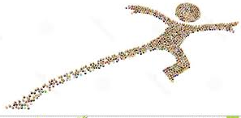
LEAP help learners leap
LEAP model
UG:
Solve many back of chapter problems, some toy projects
Comfortable with execute
Use domain concepts in pieces
Practices are implicit
Grad school / industry entry:
Do more projects, bigger, initially apprentice with seniors
Adept in concrete execution,
Start independently evaluating
Get familiar with abstraction
PhD end, industry experience:
Formulate, plan and manage projects
Integrated domain & practice
Strong in monitoring and control
Make application of practice explicit at progressive levels of abstract
Support and show how domain concept is incorporated in practice
Scaffolds & feedback to demo plan, monitor, control
Sufficient and diverse contexts of application (near to far)

Slide 46
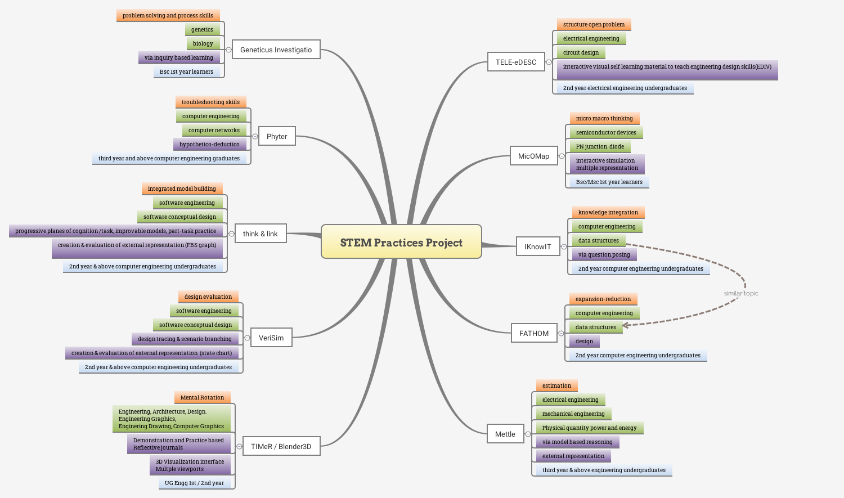
TEL environments for learning STEM practices

Slide 47
Contribute
Identify a practice relevant in your domain / area of expertise. It should be something you want your students to develop.
Think of a problem or question related to that practice.
Email these to us ☺
3) Going ahead - Imagine you have to teach it (for ex 2nd / 3rdyr Btech).
Apply the LEAP model and come up with associated tasks and prompts
Identify the key pieces or actions to apply that practice, - create Execute level tasks where something (eg a fig) is generated
Identify how one can check the goodness of the generated artefact – create Evaluate level tasks
Create Synthesize level tasks – ask students to integrate the pieces, and summarize how they solved the given problem
Come up with a different problem for the same practice and ask students how they will solve the new problem
Design prompts for students to monitor, control, plan

Slide 48
Thank you!

Slide 49
To use our TEL environments
(as is) For same topics, same problems: Go to our website or email me
~10 learning environments –
micro-macro thinking in electronics, estimation for power problems, troubleshooting in computer networks, conceptual software design, evaluation of software design, expansion-reduction thinking in data structures question posing in data structures, hypothesis testing in genetics
Use our TEL environments for your topics
Identify tasks at different levels of abstraction
(may need to) create corresponding simulation
Put tasks into TEL environments
(email me if you want to do the above)

Slide 50
Literature: Learning & teaching of practices
Science education research, Discipline-based education research, Engineering education research, Learning sciences, Cog
Inquiry labs (Krajcik et al, 2001; Hofstein et al, 2005, Hofstein & Mamlok-Naaman, 2007 and many more)
Integrated courses with scientific abilities at the core (expt design, multiple representation) (Etkina …., SM, …et al, 2006).
Iterative modeling for productive disciplinary engagement in engg design (Dasgupta, 2019).

Slide 51
Methodology: Design-based research
ANALYSIS & EXPLORATION
DESIGN &
DEVELOPMENT
EVALUATE &
REFLECT
Literature: How to support learning of thinking skill? Of topic?
Conjecture learning pathway
Instantiate learning environment design - learning activities, supports, using technology affordances
Test the design: Analyze data, interpret results.
Is desired learning happening?
Problem: Learning of thinking skill in STEM topic
Analyze cognition of experts & novices in applying thinking skill
Build / Extend theory
What is the learning mechanism?
How does design support learning?
Notes:
Flash

